Slide 1
Syntax-Directed Translation
史晓东 (Mandel)
mandel@xmu.edu.cn
Textbook: Compilers: Principles, Techniques, and Tools

Slide 2
Outline
syntax-directed definition
syntax tree
S-attributed definitions
bottom-up evaluation of S-attributed definitions
L-attributed definitions
Top-down evaluation of L-attributed definitions
Yacc and attribute evaluation
Summary
Exercises

Slide 3
Syntax-Directed Translation
Grammar symbols are associated with attributes to associate information with the programming language constructs that they represent.
Values of these attributes are evaluated by the semantic rules associated with the production rules.

Slide 4
Syntax-Directed Translation
Evaluation of these semantic rules:
  may generate intermediate codes
  may put information into the symbol table
  may perform type checking
  may issue error messages
  may perform some other activities
  in fact, they may perform almost any activities.
An attribute may hold almost any thing.
  a string, a number, a memory location, a complex record.

Slide 5
Syntax-Directed Definitions and Translation Schemes
When we associate semantic rules with productions, we use two notations:
  Syntax-Directed Definitions
  Translation Schemes
Syntax-Directed Definitions:
  give high-level specifications for translations
  hide many implementation details such as order of evaluation of semantic actions.
  We associate a production rule with a set of semantic actions, and we do not say when they will be evaluated.
Translation Schemes:
  indicate the order of evaluation of semantic actions associated with a production rule.
  In other words, translation schemes give a little bit more information about implementation details.

Slide 6
Syntax-Directed Definitions
A syntax-directed definition is a generalization of a context-free grammar in which:
  Each grammar symbol is associated with a set of attributes.
  This set of attributes for a grammar symbol is partitioned into two subsets called
    synthesized and
    inherited attributes of that grammar symbol.
  Each production rule is associated with a set of semantic rules.
Semantic rules set up dependencies between attributes which can be represented by a dependency graph.
This dependency graph restricts the evaluation order of these semantic rules.
Evaluation of a semantic rule defines the value of an attribute. But a semantic rule may also have some side effects such as printing a value.

Slide 7
Syntax-Directed Definition
In a syntax-directed definition, each production A→α is associated with a set of semantic rules of the form:
b=f(c₁,c₂,…,c_{n})
where f is a function and b can be one of the followings:
➔ b is a synthesized attribute of A and c₁,c₂,…,c_{n} are attributes of the grammar symbols in the production ( A→α ).
OR
➔ b is an inherited attribute of one of the grammar symbols in α (on the right side of the production), and c₁,c₂,…,c_{n} are attributes of the grammar symbols in the production ( A→α ).

Slide 8
Attribute Grammar
A semantic rule b=f(c₁,c₂,…,c_{n}) indicates that the attribute b depends on attributes c₁,c₂,…,c_{n}.
In a syntax-directed definition, a semantic rule may just evaluate a value of an attribute or it may have some side effects such as printing values.
An attribute grammar is a syntax-directed definition in which the functions in the semantic rules cannot have side effects (they can only evaluate values of attributes).

Slide 9
Syntax-Directed Definition -- Example
Production Semantic Rules
L → E return print(E.val)
E → E₁ + T E.val = E₁.val + T.val
E → T E.val = T.val
T → T₁ * F T.val = T₁.val * F.val
T → F T.val = F.val
F → ( E ) F.val = E.val
F → digit F.val = digit.lexval
Symbols E, T, and F are associated with a synthesized attribute val.
The token digit has a synthesized attribute lexval (it is assumed that it is evaluated by the lexical analyzer).

Slide 10
Annotated Parse Tree
A parse tree showing the values of attributes at each node is called an annotated parse tree.
The process of computing the attributes values at the nodes is called annotating (or decorating) of the parse tree.
Of course, the order of these computations depends on the dependency graph induced by the semantic rules.

Slide 11
Annotated Parse Tree -- Example
Input: 5+3*4
L
E.val=17 return
E.val=5 + T.val=12
T.val=5 T.val=3 * F.val=4
F.val=5 F.val=3 digit.lexval=4
digit.lexval=5 digit.lexval=3

Slide 12
Dependency Graph
Input: 5+3*4
L
E.val=17
E.val=5 T.val=12
T.val=5 T.val=3 F.val=4
F.val=5 F.val=3 digit.lexval=4
digit.lexval=5 digit.lexval=3

Slide 13
Syntax-Directed Definition – Example 2
Production Semantic Rules
E → E₁ + T E.loc=newtemp(), E.code = E₁.code || T.code || add E₁.loc,T.loc,E.loc
E → T E.loc = T.loc, E.code=T.code
T → T₁ * F T.loc=newtemp(), T.code = T₁.code || F.code || mult T₁.loc,F.loc,T.loc
T → F T.loc = F.loc, T.code=F.code
F → ( E ) F.loc = E.loc, F.code=E.code
F → id F.loc = id.name, F.code=“”
Symbols E, T, and F are associated with synthesized attributes loc and code.
The token id has a synthesized attribute name (it is assumed that it is evaluated by the lexical analyzer).
It is assumed that || is the string concatenation operator.

Slide 14
Syntax-Directed Definition – Inherited Attributes
Production Semantic Rules
D → T L L.in = T.type
T → int T.type = integer
T → real T.type = real
L → L₁ , id L₁.in = L.in, addtype(id.entry,L.in)
L → id addtype(id.entry,L.in)
Symbol T is associated with a synthesized attribute type.
Symbol L is associated with an inherited attribute in.

Slide 15
A Dependency Graph – Inherited Attributes
Input: real p, q
D L.in=real
T L T.type=real L₁.in=real addtype(q,real)
real L , id
addtype(p,real) id.entry=q
id id.entry=p
parse tree dependency graph

Slide 16
Evaluation Order
a topological sort of a directed graph is any ordering m1, m2, ..., mk of the nodes of the graph such that edges go from nodes earlier in the ordering to later nodes; that is, if mi -> mj is an edge from mi to mj, then mi appears before mj in the ordering
Any topological sort of a dependency graph gives a valid order in which semantic rules associated with the nodes in a parse tree can be evaluated.

Slide 17
Syntax Trees
Syntax tree: an intermediate representation of the compiler’s input.
Use of syntax tree can decouple Translation from Parse trees. e.g. C or Pascal compilers can use the same syntax tree for some of the constructs.
we can use syntax-directed definitions to construct syntax trees
Employment of the synthesized attribute nptr (pointer)
PRODUCTION SEMANTIC RULE
E → E₁ + T E.nptr = mknode(“+”,E₁.nptr ,T.nptr)
E → E₁ - T E.nptr = mknode(“-”,E₁.nptr ,T.nptr)
E → T E.nptr = T.nptr
T → (E) T.nptr = E.nptr
T → id T.nptr = mkleaf(id, id.lexval)
T → num T.nptr = mkleaf(num, num.val)
mknode, mkleaf is two aux functions

Slide 18
Draw the Syntax Tree
+
a-4+c
-
id
to entry for c
id
num 4
to entry for a

Slide 19
Directed Acyclic Graphs for Expressions
a + a * ( b – c ) + ( b – c ) * d
+
+
*
*
d
a
-
b
c

Slide 20
S-Attributed Definitions
Syntax-directed definitions are used to specify syntax-directed translations.
To create a translator for an arbitrary syntax-directed definition can be difficult.
We would like to evaluate the semantic rules during parsing (i.e. in a single pass, we will parse and we will also evaluate semantic rules during the parsing).
We will look at two sub-classes of the syntax-directed definitions:
  S-Attributed Definitions: only synthesized attributes used in the syntax-directed definitions.
  L-Attributed Definitions: in addition to synthesized attributes, we may also use inherited attributes in a restricted fashion.
To implement S-Attributed Definitions and L-Attributed Definitions we can evaluate semantic rules in a single pass during the parsing.
Implementations of S-attributed Definitions are a little bit easier than implementations of L-Attributed Definitions

Slide 21
Bottom-Up Evaluation of S-Attributed Definitions
We put the values of the synthesized attributes of the grammar symbols into a parallel stack.
  When an entry of the parser stack holds a grammar symbol X (terminal or non-terminal), the corresponding entry in the parallel stack will hold the synthesized attribute(s) of the symbol X.
We evaluate the values of the attributes during reductions.
A → XYZ A.a=f(X.x,Y.y,Z.z) where all attributes are synthesized.
stack parallel-stack
top →
➔ top →
Z
Y
X
.
Z.z
Y.y
X.x
.
A
.
A.a
.

Slide 22
Bottom-Up Eval. of S-Attributed Definitions (cont.)
Production Semantic Rules
L → E return print(val[top-1])
E → E₁ + T val[ntop] = val[top-2] + val[top]
E → T
T → T₁ * F val[ntop] = val[top-2] * val[top]
T → F
F → ( E ) val[ntop] = val[top-1]
F → digit
At each shift of digit, we also push digit.lexval into val-stack.
At all other shifts, we do not put anything into val-stack because other terminals do not have attributes (but we increment the stack pointer for val-stack).
ntop = top – r + 1
r = no. of symbols in the right side of the production

Slide 23
Canonical LR(0) Collection for The Grammar
L
I₁:
I₀:
L’→.L
L →.Er
E →.E+T
E →.T
T →.T*F
T →.F
F →.(E)
F →.d
L’→L.
L →E.r
E →E.+T
E →T.
T →T.*F
T →F.
F → (.E)
E →.E+T
E →.T
T →.T*F
T →.F
F →.(E)
F →.d
F →d.
I₇:
L →Er.
E →E+.T
T →.T*F
T →.F
F →.(E)
F →.d
T →T*.F
F →.(E)
F →.d
F →(E.)
E →E.+T
I₁₁:
E →E+T.
T →T.*F
T →T*F.
F →(E).
*
9
r
T
E
I₂:
+
I₈:
F
4
(
5
d
T
I₃:
6
*
F
I₄:
I₉:
F
(
I₁₂:
I₅:
(
E
5
d
6
T
I₁₀:
)
I₁₃:
3
+
F
4
8
(
d
I₆:
5
d
6

Slide 24
Bottom-Up Evaluation -- Example
At each shift of digit, we also push digit.lexval into val-stack.
stack val-stack input action semantic rule
0 5+3*4r s6 d.lexval(5) into val-stack
0d6 5 +3*4r F→d F.val=d.lexval – do nothing
0F4 5 +3*4r T→F T.val=F.val – do nothing
0T3 5 +3*4r E→T E.val=T.val – do nothing
0E2 5 +3*4r s8 push empty slot into val-stack
0E2+8 5- 3*4r s6 d.lexval(3) into val-stack
0E2+8d6 5-3 *4r F→d F.val=d.lexval – do nothing
0E2+8F4 5-3 *4r T→F T.val=F.val – do nothing
0E2+8T11 5-3 *4r s9 push empty slot into val-stack
0E2+8T11*9 5-3- 4r s6 d.lexval(4) into val-stack
0E2+8T11*9d6 5-3-4 r F→d F.val=d.lexval – do nothing
0E2+8T11*9F12 5-3-4 r T→T*F T.val=T₁.val*F.val
0E2+8T11 5-12 r E→E+T E.val=E₁.val*T.val
0E2 17 r s7 push empty slot into val-stack
0E2r7 17- $ L→Er print(17), pop empty slot from val-stack
0L1 17 $ acc

Slide 25
Traversals of Parse-trees
DF traversal is a natural traversal that will allow the systematic evaluation of attributes.
procedure dfvisit(n:node)
{
for each child m of n from left to right do
{
evaluate inherited attributes of m;
dfvisit(m)
}
evaluate synthesized attributes of n
}

Slide 26
L-Attributed Definitions
A syntax-directed definition is called L-Attributed if
  In the semantic rules of a production
  A→ X₁…X_{n} the inherited attributes of X_{j} depend only on
    The attributes (synthesized or inherited) of the symbols X₁…X_{j-1}
    The inherited attributes of A
All S-attributed Definitions are also L-attributed because the restrictions apply only to inherited attributes.

Slide 27
Example
Example of a Syntax-Directed Definition that is not L-attributed.
PRODUCTION SEMANTIC RULE
  A → LM L.i = f₁(A.i)
  M.i = f₂(L.s)
  A.s = f₃(M.s)
  A → QR R.i = f₄(A.i)
  Q.i = f₅(R.s)
  A.s = f₆(Q.s)

Slide 28
Translation Schemes
A CFG with “semantic actions” embedded into its productions. Useful for binding the order of evaluation into the parse-tree.
As before semantic actions might refer to the attributes of the symbols.
    Example.
    expr → expr + term { print(“+”) }
    expr → expr - term { print(“-”) }
    expr → term
    term → 0 { print(“0”) }
    …
    term → 9 { print(“9”) }
=> DF Traversing a parse tree for a Translation-Scheme produces the translation.

Slide 29
Writing Translation Schemes
Start with a Syntax-Directed Definition.
In General: Make sure that we never refer to an attribute that has not been defined already.
For S-Attributed Definitions, we simply put all semantic rules into {…} at the rightmost of each production.
If both inherited and synthesized attributes are involved:
  An inherited attribute for a symbol on the RHS of a production must be computed in an action before that symbol.
  An action must not refer to a synthesized attribute of a symbol that is to the right.
  A synthesized attribute for the NT on the LHS can only be computed after all attributes it references are already computed. (the action for such attributes is typically placed in the rightmost end of the production).
L-attributed definitions are suited for the above…

Slide 30
Examples
S → A₁ {S.s = A₁.s+A₂.s} A₂
A→ a {A.s = 1}
This will not work…
On the other hand this is good:
S → A₁ A₂ {S.s = A₁.s+A₂.s}
A→ a {A.s = 1}

Slide 31
Examples II
S → A₁ A₂ {A₁.in = 1; A₂.in = 2}
A→ a {print(A.in)}
This will not work…
On the other hand this is good:
S → {A₁.in = 1; A₂.in = 2} A₁ A₂
A→ a {print(A.in)}
Or even:
S → {A₁.in = 1} A₁ {A₂.in = 2} A₂
A→ a {print(A.in)}

Slide 32
A “Case Study” I
Math Formatting Language (EQN).
S → B
B → B B
B → B sub B
B → text
“sub” is a reserved word.
“text” is interpreted by the lex.an. as any string without spaces.
e.g. “E sub 1 .val” is read by the Lexical Analyzer as text sub text text
E
.val
1

Slide 33
Case Study II
How do we want to interpret strings such as
text sub text text
?
Every text is a “TextBox” or simply a “box”
        S → B
        B → B B
        B → B sub B
        B → text
In the grammar B stands for a box and S for a statement.
Intended translation is a typesetting of the given text,
interpreting B sub B as B_{B}

Slide 34
Case Study III
First we give a syntax-directed definition.
We employ one attribute for S called ht that will give the height of the statement (synthesized)
The height of text is specified by the lexical analyzer
For B we employ a ht attribute (synthesized) as well as an attribute ps (inherited) that will denote a “multiplier.”
Also the functions shrink( ), max( ), disp( )
    PRODUCTION SEMANTIC RULE
    S→ B B.ps = 10; S.ht = B.ht
    B → B₁ B₂ B₁.ps = B.ps; B₂.ps = B.ps;
    B.ht = max(B₁.ht, B₂.ht)
    B → B₁ sub B₂ B₁.ps = B.ps; B₂.ps = shrink(B.ps);
    B.ht = disp(B₁.ht, B₂.ht)
    B → text B.ht = text.h * B.ps
Observe that the definition is L-attributed

Slide 35
Case Study IV
PRODUCTION SEMANTIC RULE
S→ B B.ps = 10; S.ht = B.ht
B → B₁ B₂ B₁.ps = B.ps; B₂.ps = B.ps;
B.ht = max(B₁.ht, B₂.ht)
B → B₁ sub B₂ B₁.ps = B.ps; B₂.ps = shrink(B.ps);
B.ht = disp(B₁.ht, B₂.ht)
B → text B.ht = text.h * B.ps
TRANSLATION SCHEME
S→ {B.ps = 10} B { S.ht = B.ht }
B → {B₁.ps = B.ps} B₁ {B₂.ps = B.ps } B₂ {B.ht = max(B₁.ht, B₂.ht) }
B → {B₁.ps = B.ps} B₁ sub {B₂.ps = shrink(B.ps)} B₂ {B.ht = disp(B₁.ht, B₂.ht)}
B → text {B₁.ht = text.h * B.ps }

Slide 36
Top-Down Evaluation of L-Attributed Definitions
Implementing L-attributed Definitions during “top-down predictive parsing.”
Recall top-down predictive parsing:
  Grammar has no left-recursion and it is left-factored.

Slide 37
Eliminating Left-Recursion From Translation Schemes
TRANSLATION SCHEME
E→ E₁ + T {E.val = E₁.val + T.val}
E→ E₁ - T {E.val = E₁.val - T.val}
E→ T {E.val = T.val}
T→ (E) {T.val = E.val}
T → num {T.val = text.val }
Grammar with left recursion removed:
E→ T R {E.val = ?}
R→ + T R {?}
R→ - T R {?}
R → ε {?}
T→ (E) {T.val = E.val}
T → num {T.val = text.val }

Slide 38
Eliminating Left-Recursion From Translation Schemes, II
TRANSLATION SCHEME
E→ E₁ + T {E.val = E₁.val + T.val}
E→ E₁ - T {E.val = E₁.val - T.val}
E→ T {E.val = T.val}
T→ (E) {T.val = E.val}
T → num {T.val = text.val }
Grammar with left recursion removed:
E→ T {R.i = T.val} R {E.val = R.s }
R→ + T {R₁.i = R.i + T.val} R₁ {R.s = R₁.s}
R→ - T {R₁.i = R.i - T.val} R₁ {R.s = R₁.s}
R → ε {R.s = R.i}
T→ (E) {T.val = E.val}
T → num {T.val = text.val }
Employ for R
  an inherited, i and
  a synthesized attribute s.

Slide 39
Example
E
T.val = 9
R.i = 9
R.i = 4
num.val = 9
-
T.val = 5
+
T.val = 2
R.i = 6
num.val = 5
num.val = 2
∈

Slide 40
Eliminating Left-Recursion From Translation Schemes, III
In GENERAL,TRANSLATION SCHEME with synthesized attributes
A→ A₁ Y {A.a = g(A₁.a , Y.y) }
A→ X {A.a = f(X.x) }
Translation scheme with left recursion removed:
A→ X {R.i = f(X.x)} R {A.a = R.s) }
R→ Y {R₁.i = g(R.i, Y.y)} R₁ {R.s = R₁.s) }
R → ε{R.s = R.i}

Slide 41
Example
A.a = g(g(f(X.x),Y₁.y),Y₂.y)
A
X
R.i = f(X.x)
A.a = g(f(X.x),Y₁.y))
Y₂
Y₁
R.i = g(f(X.x),Y₁.y))
A.a = f(X.x)
Y₁
Y₂
X
R.i = g(g(f(X.x),Y₁.y),Y₂.y)
∈

Slide 42
Eliminating Left-Recursion from Translation Schemes, IV
E→ E₁ + T {E.nptr = mknode(“+”, E₁.nptr , T.nptr )}
E→ E₁ - T {E.nptr = mknode(“-”, E₁.nptr , T.nptr )}
E→ T {E.nptr = T.nptr }
T→ (E) {T.nptr = E.nptr}
T→ id {T.nptr = mkleaf(id, id.entry)}
T→ num {T.nptr = mkleaf(num, num.entry)}
Translation Scheme with left recursion removed:
E→ T { ??? } R { ??? }
R→ + T { ??? } R₁ { ??? }
R→ - T { ??? } R₁ { ??? }
R → ε {R.s = R.i}
T→ (E) {T.nptr = E.nptr}
T→ id {T.nptr = mkleaf(id, id.entry)}
T→ num {T.nptr = mkleaf(num, num.entry)}

Slide 43
Eliminating Left-Recursion from Translation Schemes, V
E→ E₁ + T {E.nptr = mknode(“+”, E₁.nptr , T.nptr )}
E→ E₁ - T {E.nptr = mknode(“-”, E₁.nptr , T.nptr )}
E→ T {E.nptr = T.nptr }
T→ (E) {T.nptr = E.nptr}
T→ id {T.nptr = mkleaf(id, id.entry)}
T→ num {T.nptr = mkleaf(num, num.entry)}
Translation Scheme with left recursion removed:
E→ T { R.i = T.nptr } R { E.nptr =R.s}
R→ + T { R₁.i = mknode(“+”, R.i , T.nptr )} R₁ { R.s = R₁.s }
R→ - T { R₁.i = mknode(“-”, R.i , T.nptr )} R₁ { R.s = R₁.s }
R → ε {R.s = R.i}
T→ (E) {T.nptr = E.nptr}
T→ id {T.nptr = mkleaf(id, id.entry)}
T→ num {T.nptr = mkleaf(num, num.entry)}

Slide 44
Top-Down Evaluation of L-Attributed Definitions
实现方法
  先构造句法树，然后计算属性
  采用递归下降法(Recursive Descent Parser)
  基于预测分析法的实现
  基于LR分析器的实现

Slide 45
Removing Embedding Action from Translation Schemes
在翻译模式里，可以在产生式右部的中间插入语义动作。
In the bottom-up translation method, all translation actions being at the right end of the production.
In the predictive-parsing method, we normally use translation schemes to make attribute evaluation easier.
E → T R
R → + T { print(‘+’) } R | - T { print(‘-’) } R | ∈
T → num { print(num.val) }

Slide 46
Removing Embedding Action from Translation Schemes
The transformation insert new marker non-terminal generating ∈ into the base grammar.
Distinct marker for each action.
E → T R
R → + T { print(‘+’) } R | - T { print(‘-’) } R | ∈
T → num { print(num.val) }
E → T R
R → + T M R | - T N R | ∈
T → num { print(num.val) }
M → ∈ { print(‘+’) }
N → ∈ { print(‘-’) }

Slide 47
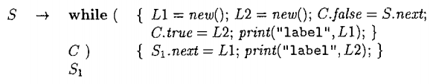

基于预测分析法的实现
生成while语句中间代码的SDT（ Syntax-Directed Translation Schemes ）
1. 边分析边生成
2. 代码作为综合属性

Slide 48
基于预测分析法的实现
原来预测分析法的栈中，只有文法符号。为了支持属性计算，我们引入新的标记非终结符（称为动作符），这些用来进行语义计算。另外，文法符号对应的属性值也必须记录在分析栈中。为了支持综合属性的计算，所有包含综合属性的非终结符后面也必须加上标记非终结符（称为综合符）

Slide 49
基于预测分析法的实现
原来预测分析法的栈中，只有文法符号。为了支持属性计算，我们引入新的标记非终结符（称为动作符），这些用来进行语义计算。另外，文法符号对应的属性值也必须记录在分析栈中。为了支持综合属性的计算，所有包含综合属性的非终结符后面也必须加上标记非终结符（称为综合符）
为何少了2个Action？

Slide 50
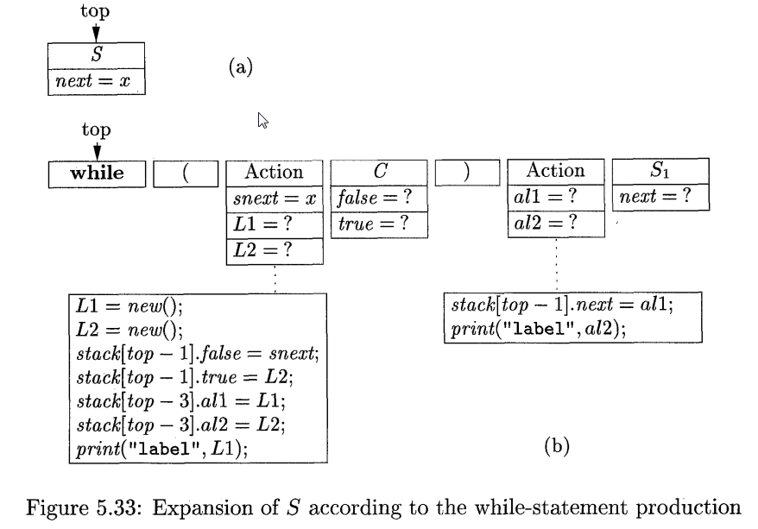
基于预测分析法的实现

Slide 51
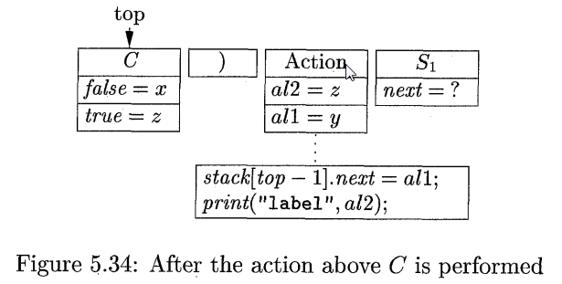
基于预测分析法的实现

Slide 52
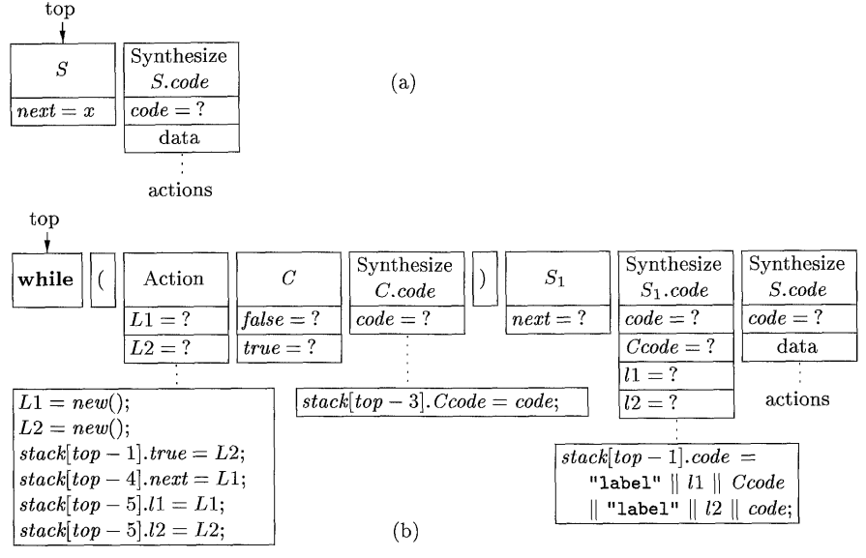
基于预测分析法的实现

Slide 53
The Picture So Far
We discussed “bottom up translation” For S-Directed Definitions.
Simple Idea: Use additional stack space to store attribute values for Non-terminals. During Reduce Actions update attributes in stack accordingly.
We also discussed “top-down translation.”
Works exceptionally well with L-attributed Definitions (with corresponding translation schemes)
Nevertheless we must make sure that the underlying grammar is suitable for predictive parsing.
  Grammar has no left-recursion and it is left-factored.
另外，实现起来也比较麻烦。

Slide 54
自底向上属性计算的文法变换
自底向上分析是主流方法。为了采用自底向上分析，文法需进行适当变换：
  翻译模式变换
  包含继承属性的文法的变换

Slide 55
包含继承属性的文法的变换
Pascal的声明，如m, n : integer
D → L : T
T → integer | char
L → L, id | id
我们需要把变量的类型信息记录在符号表，则以上文法需要采用继承属性把L的属性值传递给T

Slide 56
包含继承属性的文法的变换
用综合属性代替继承属性
Pascal的声明，如m, n : integer
D → L : T
T → integer | char
L → L, id | id
改成从右向左归约
D → id L
L → , id L | : T
T → integer | char

Slide 57
包含继承属性的文法的变换
用综合属性代替继承属性
Pascal的声明，如m, n : integer
D → L : T
T → integer | char
L → L, id | id
改成从右向左归约
D → id L
L → , id L | : T
T → integer | char
D
D
id
id
L
L
,
,
id
id
L
L
:
:
T
T
integer
integer

Slide 58
包含继承属性的文法的变换
D → id L { addtype (id. entry, L. type)}
L → , id L₁ {L. type := L₁. Type;
addtype (id. entry, L₁. type)}
L → : T {L. type := T. type}
T → integer {T. type := integer}
T → real {T. type := real}

Slide 59
定理(Knuth 1968)
任何含继承属性的文法都可以在语言不变的前提下，被改造成只含综合属性的文法。

Slide 60
Inherited Attributes and Bottom Up Translation
Consider the translation scheme:
PRODUCTION SEMANTIC RULE
D → T L L.in = T.type
T → int T.type = integer
T → real T.type = real
L → L₁ , id L₁.in = L.in
addtype(id.entry, L.in)
L → id addtype(id.entry, L.in)

Slide 61
Parsing Example.
Attempt B-U parsing over real p, q, r
Input | State | Production Rule
real p, q, r | -
p, q, r | real
p, q, r | T | T → real
, q, r | T p
, q, r | T L | L → id
q, r | T L ,
, r | T L , q
, r | T L | L → L ,id
r | T L ,
 | T L , r
 | T L | L → L ,id
 | D | D → T L

Slide 62
Bottom Up Translation with Inherited Attributes
Try to predict the location in the stack that you can recover the value of the inherited attribute you need.
PRODUCTION SEMANTIC RULE
D → T L
T → int val[ntop] = integer
T → real val[ntop] = real
L → L₁ , id addtype(id.entry, val[top-3])
L → id addtype(id.entry, val[top-1])
Dangerous
Stuff !!!

Slide 63
Yacc的属性计算
支持综合属性的计算
支持翻译方案
如果其在栈中的位置可以被预测,也可以用继承属性

Slide 64
A Brief Look into Yacc
Terminals and Non-terminals in Yacc they have a “semantic value” (one attribute).
The attribute type is specified by YYSTYPE
Different typing for attributes is achieved through %union
The current terminal semantic values are passed by Lex in the variable yylval (specified by Lex).

Slide 65
Semantic values for a certain production are specified by the symbols $$, $1, $2, $3, …
For a certain production, LHS is $$ and $1, $2, $3, … denote the semantic values of each item in the RHS.
Also one can use $0, $-1, $-2, … to peek into the Yacc stack (beyond the current production). Dangerous Stuff !!!

Slide 66
A Brief Look into Yacc,II
Frequently one needs more versatility in defining the semantic values of non-terminals. (i.e., various different attributes).
We define a collection of data types using %union
We determine the attribute type of each symbol by using the %type declaration.

Slide 67
Defining Attributes in Lex/Yacc
typedef struct { int value; } myattribute;
%union{ int number;
int ident;
myattribute myattribute_type; }
%token <ident> ID
%token <number> NUM
%type <myattribute_type> expr
%left '+'
%%
expr : ID { printf("%d\n", $1); $$.value = $1; }
| NUM { printf("%d\n", $1); $$.value = $1; }
| expr '+' expr { $$.value = $1.value + $3.value; printf("%d\n", $$.value); }
;

Slide 68
%%
*************** LEX FILE *****************
id [A-Za-z][A-Za-z0-9]*
num [0-9]+
ws [ \t]+
%%
{ws} /* do nothing */
{id} { yylval.ident = yytext[0] – ‘a’; return ID; } /*一个字符*/
{num} { yylval.number = atoi(yytext); return NUM; }
. { return yytext[0]; }
%%

Slide 69
The Stack of Yacc
Yacc employs and maintains a stack that contains all semantic values/ attributes.
When Yacc makes a shift action
  It enters into the stack the corresponding token identifier along with its semantic value as this is determined by YYSTYPE and/or %token declaration. The value is provided by yylval
When Yacc makes a reduce action for a production
A: X₁ X₂ { $$ = f ($1,$2) };
  stack is interpreted as: …[X₁,$1] [X₂,$2]
  I.e., yacc pops two stack elements and uses their semantic values to fill $1,$2
  After the action: …[A,$$]

Slide 70
Attributes and Yacc
Standard rules is that we cannot refer to any semantic-value or attribute to the “right.”
E.g. the following will produce an error
A: B C { $4 = f ($1,$2) } D;
Usually we do the computation for $$ at the end of a production.

Slide 71
Attributes and Yacc, II
PRODUCTION SEMANTIC RULE
D → T L L.in = T.type
T → int T.type = integer
T → real T.type = real
L → L₁ , id L₁.in = L.in
addtype(id.entry, L.in)
L → id addtype(id.entry, L.in)
Dangerous
Stuff !!!
This is wrong:
If we have inherited attributes, we have to look into the stack:
%type <string> T
%type <string> L
%%
D: T { $3 = $1 }L;
L: ID {addtype($1,$0)};

Slide 72
An better way: rewrite grammar
NEW PRODUCTIONS SEMANTIC RULE YACC
D → L
L → L1 , id L.type = L1.type
addtype(id.entry, L1.type) addtype($3,$1)
L → T id L.type = T.type
addtype(id.entry, T.type) addtype($3,$1)
T → int T.type = integer
T → real T.type = real

Slide 73
Which way to use?
If you want to prove to your friends what a yacc-freak you are.
+ you want to show that you really understand grammars.
+ you want to make it really hard for other people to understand your YACC programs.
IN THIS CASE prefer using $0,$-1,$-2,…

Slide 74
Translation with Yacc
Define the main attribute of any construct to be a char buffer of a certain size + have any additional typedef struct {char* translation; int var;} myattribute;
Then define semantics actions appropriately:
e.g.
expr : NUM
{ varcounter++;
append($$.translation, concat(“V”, varcounter, “=“ , $1));
$$.var = varcounter;
}
| expr ‘ +‘ expr
{ varcounter++;
append($$.translation, $1.translation);
append($$.translation, $3.translation);
append($$.translation, concat(“V”, varcounter,“=“ ,“V”, $1.var, “+”, “V”, $3.var));
$$.var = varcounter;
}
;

Slide 75
简单代码生成演示
tran.y
tran.l
  Flex tran.l
  Yacc –d tran.y
  bcc32 -etran y.tab.c lex.yy.c
  tran tran.input

Slide 76
Summary
掌握综合属性,继承属性,S-属性定义,L-属性定义的概念
S-属性定义的自底向上计算
L-属性定义的自顶向下计算
用Yacc进行语法制导翻译

Slide 77
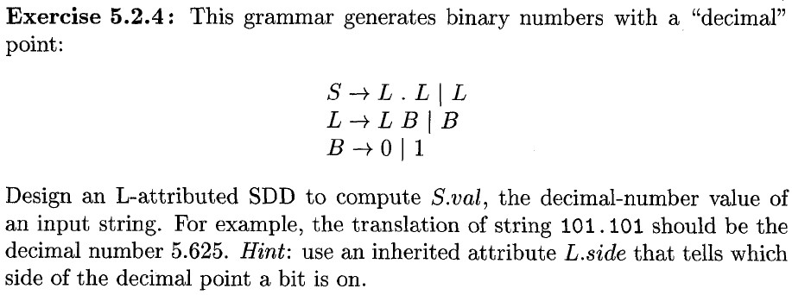
exercises
5.2.4

Slide 78
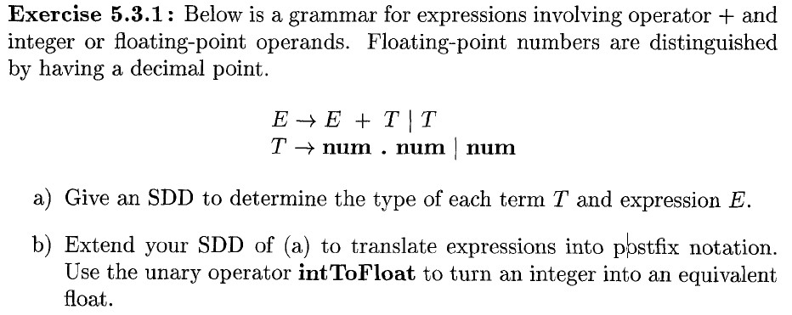
5.3.1

Slide 79
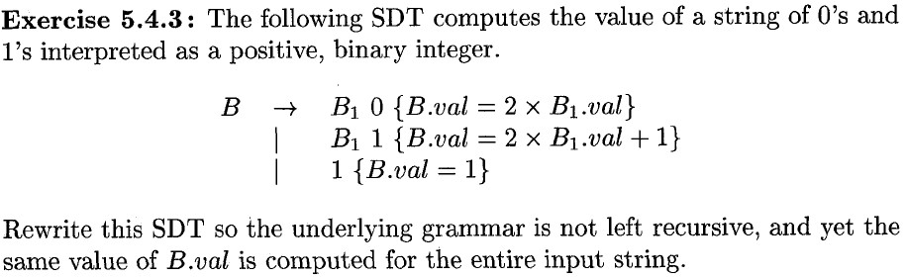
5.4.3

